Slide 1
Good Morning Everyone…☺
My Name is Nithish Kumar,
Studying Final Year CSE

Slide 2

My Project Name is
NUMBER IN MIND

Slide 3
Game Description
It is a Simple Math Game.
We can choose a number from 1 to 10.
And click “yes”, if the number is present in the list.
Else click “no”.
It will predict the result.

Slide 4
The Library is have used is
Tkinter

Slide 5
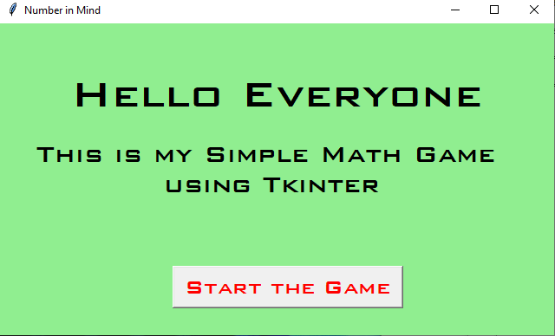
Home Page

Slide 6
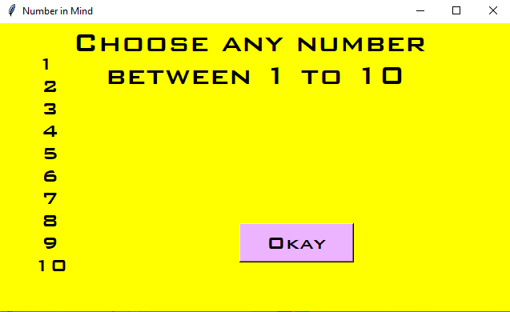
Game
Home Page

Slide 7
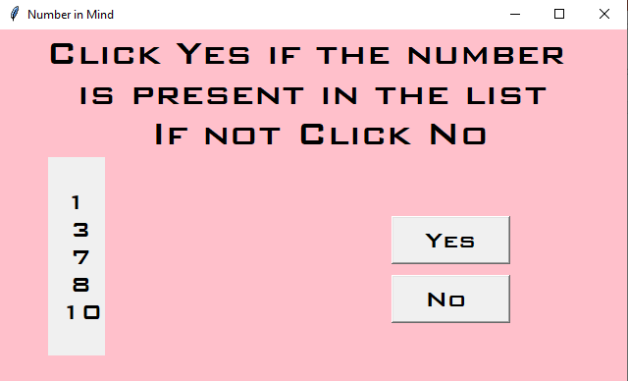
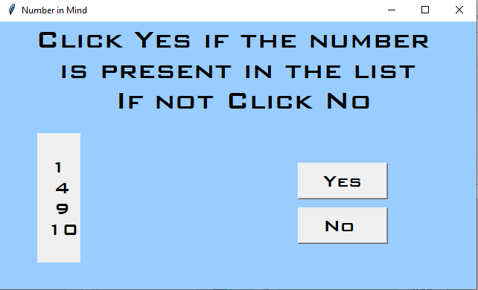
Game Page 1 & 2

Slide 8
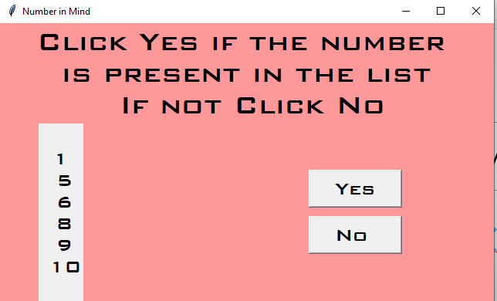
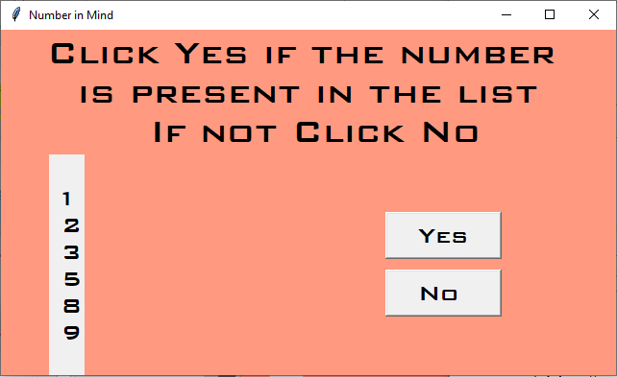
Game Page 3 & 4

Slide 9
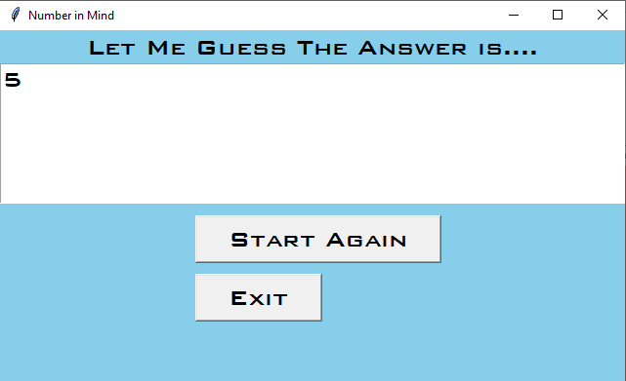
Result Page

